Slide 1
ActiveRGCN:
Finding Valuable Samples for Heterogeneous GNN Training
Xinyu Zhao, Haowei Jiang, Hang Zhang & Nuocheng Pan

Slide 2
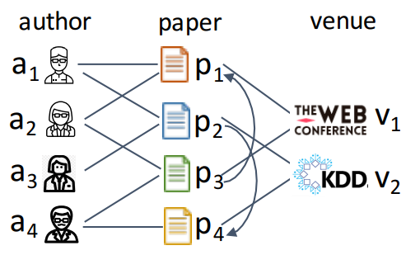
Heterogeneous Information Network (HIN)
Containing various types of nodes and edges (relationships)
E.g.: Citation network
Node type: Papers, authors, conferences, …
Edge type: Author-Paper, Paper-Conference, Paper-paper, …
Closer to more real world applications
Credit: picture from Heterogeneous Graph Neural Network
Notes:
In our project, we mainly focus on the heterogeneous information network. Unlike the homogeneous information network, or graph, HIN contains various types of nodes and edges. Like the citation network here, we have nodes for papers, authors and conferences, and we also have author-paper edges, paper conference edges and paper paper edges representing different relationships. So we can see that the HIN is closer to real world applications.

Slide 3
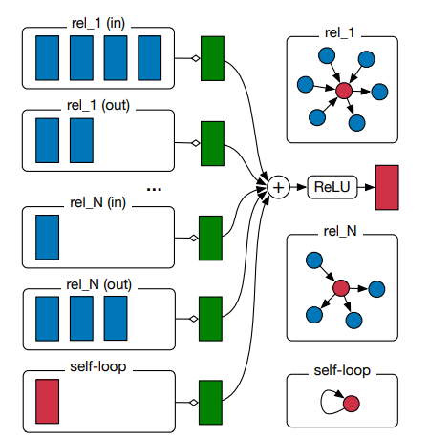
Relational Graph Convolutional Network
An extension of GCN on HIN
Compared with GCN
Directed Graph v.s. Undirected Graph
Aggregate neighbourhood information independently for each edge (considering relationship type and direction)
Similar to GCN in homogeneous setting, RGCN is a very classic baseline for HIN network embedding.
Credit: picture from Modeling Relational Data with Graph Convolutional Networks
Notes:
RGCN is an extension of GCN to calculate network embedding for HIN. Compared with GCN, RGCN considers networks as directed graphs instead of undirected graph and thus aggregates neighbourhood information for each kind of edges considering relationship type and directions. And similar to GCN in homogeneous setting, RGCN is a very classic baseline for HIN network embedding.

Slide 4
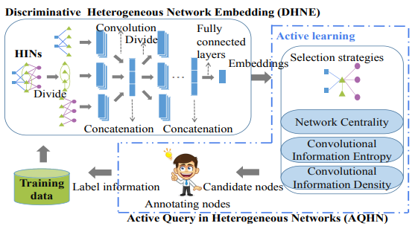
ActiveHNE
An Active learning framework for HIN.
Proposed a new heterogeneous network embedding methods.
Proposed informative scored-based active learning framework together with a multi-armed bandit mechanism to dynamic update weight.
Credit: picture from ActiveHNE: Active Heterogeneous Network Embedding
Notes:
Team 13 introduced the idea of active learning last time, aiming to reduce the labelling requirement for the dataset, but the famous AGE framework and their proposed methods introduced in their presentation only work in homogeneous settings. For HIN, the first ever active learning framework is the ActiveHNE. In the paper of ActiveHNE, it proposed a new heterogeneous network embedding methods call DHNE as well as an active learning framework based on informative scores and multi-armed bandit.

Slide 5
ActiveHNE Problem
Experiment setting not fair enough
GCN as baseline while it is a homogeneous network
Possible extension: Have active select working on other networks?
Use Active Select on RGCN: ActiveRGCN

Slide 6
Active Select Strategy
To select most representative nodes for learning without going through all
Given Node v, evaluate following 3 rewards:
Network Centrality (NC)
The representativeness of v, measure degree
Convolutional Information Entropy (CIE)
Uncertainty of v, by weighted sum of neighbor uncertainties
Convolutional Information Density (CID)
Representativeness of v in the embedding space based on neighbor nodes
Weighted sum as a reward function
Rewards = NC_reward * NC_weight + CIE_reward * CIE_weight +
CID_reward * CID_weight

Slide 7
Reward Function Tuning
An AL strategy inspired from Combinatorial Multi-Arm Bandit (MAB) problem
A RL method
Given a budget number of iterations
What player should do with an Arm, to maximize reward
Combinatorial allows to play multiple Arms during one iteration
Each arm corresponds to one of our rewards
Dynamic update of the weights
An estimation of the importance of a given node
Select nodes by highest reward function with most change embedding: more new information

Slide 8
Selection Process: Pseudocodes
for ITER times:
Select BATCH nodes from Training Set have top Rewards
Add selected nodes to Labeled Set, remove them from Training Set
Create new Model (Model on previous ITER is destroyed)*
for EPOCH passes:
Train Model on Labeled Set once
Take Embedding from Model
Update Weights in Rewards from Embedding using MAB
Final Labeled Set have Size= ITER * BATCH
Notes:
random seed -> RGCN -> reward function/multi-arm bandit -> add new selected node

Slide 9
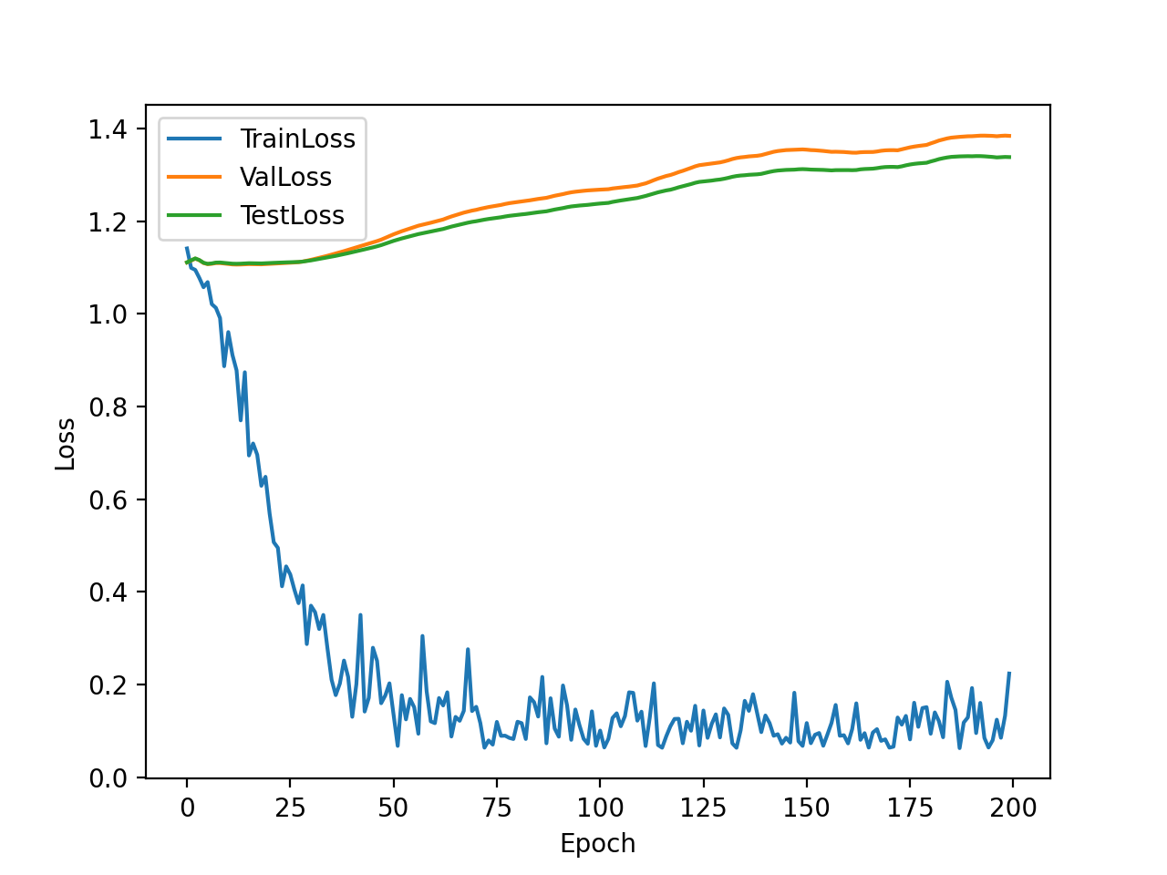
Dataset & Setting
ActiveHNE setting: epoch 200, iteration 40, batch size 20 for all dataset, save the last epoch result
Our setting: epoch 50, iteration 40, batch size 80 for Cora, batch size 20 for DBLP and MovieLens, save the best model (lowest validation loss)
MovieLens
Dataset | Entities | Edges | Entity Type | Edge Type | class_num | training set size
Cora | 56,670 | 244,088 | 3 | 3 | 10 | 3911
DBLP | 37,791 | 170,803 | 4 | 3 | 4 | 1014
MovieLens | 28,491 | 138,352 | 4 | 4 | 3 | 918

Slide 10
Experiment Design
Apply active select to RGCN model, compare performance of ActiveHNE and ActiveRGCN , show the applicability of active select
Compare ActiveRGCN and RGCN
Ablation Study
Notes:
Active select能不能被apply到其他 existing model上
unfair experimental settings, unfair example

Slide 11
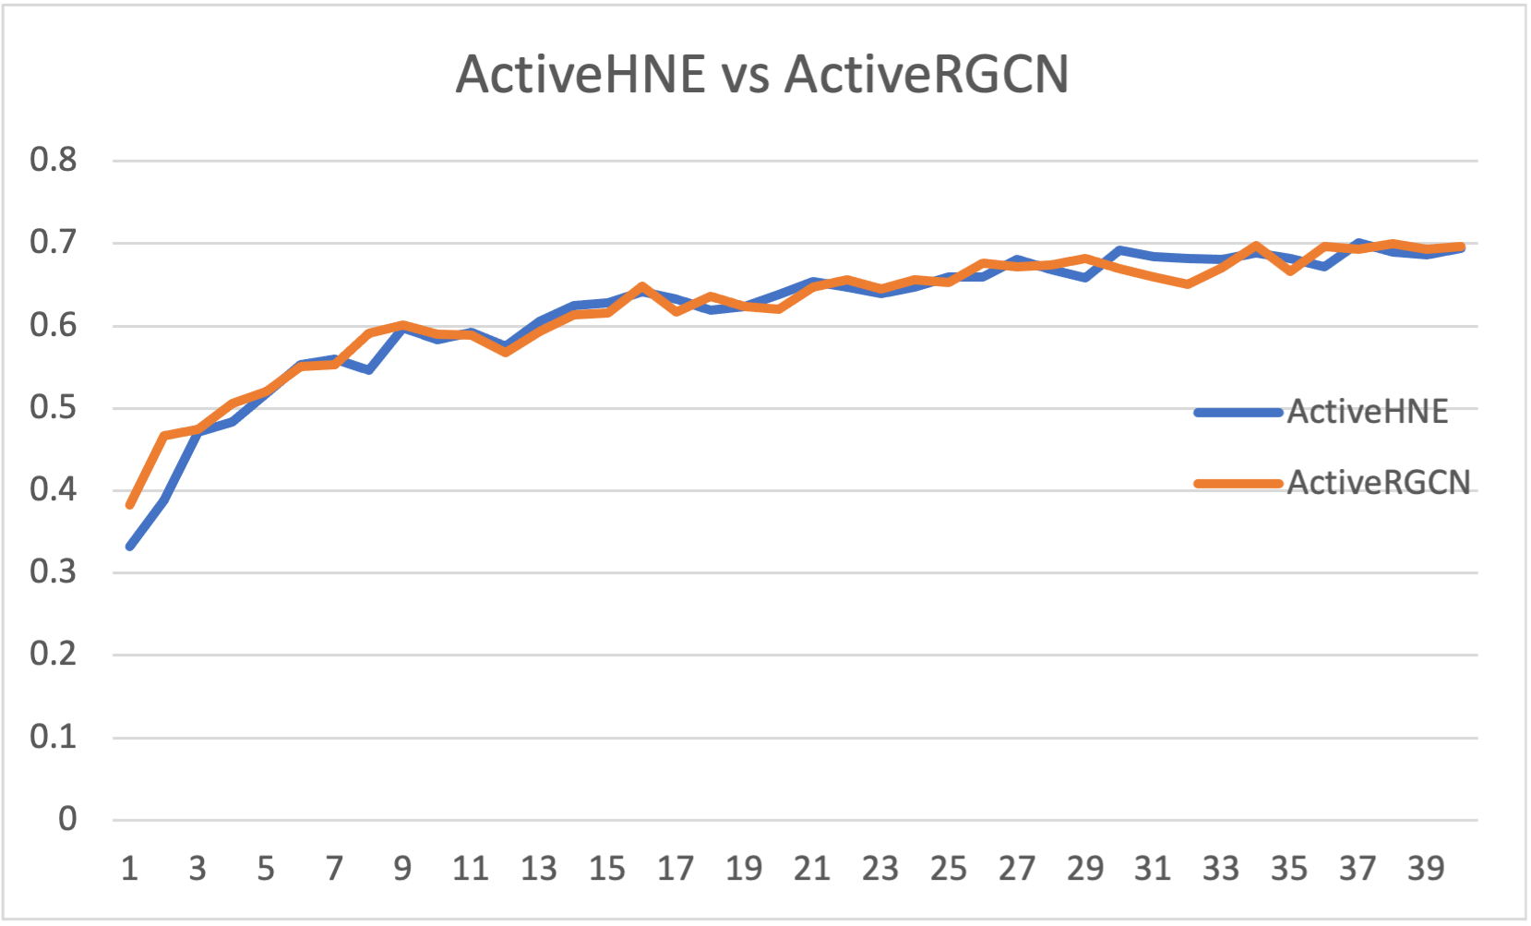
ActiveHNE vs ActiveRGCN
ActiveRGCN has simpler network structure, less training time, but similar performance to ActiveHNE
Active select could be apply to other graph neural network, not only depend on DHNE or RGCN
test_acc
num_iteration
Notes:
更简单的model，更少的epoch，更少的training time，可以apply到其他model上，不依赖现有model

Slide 12
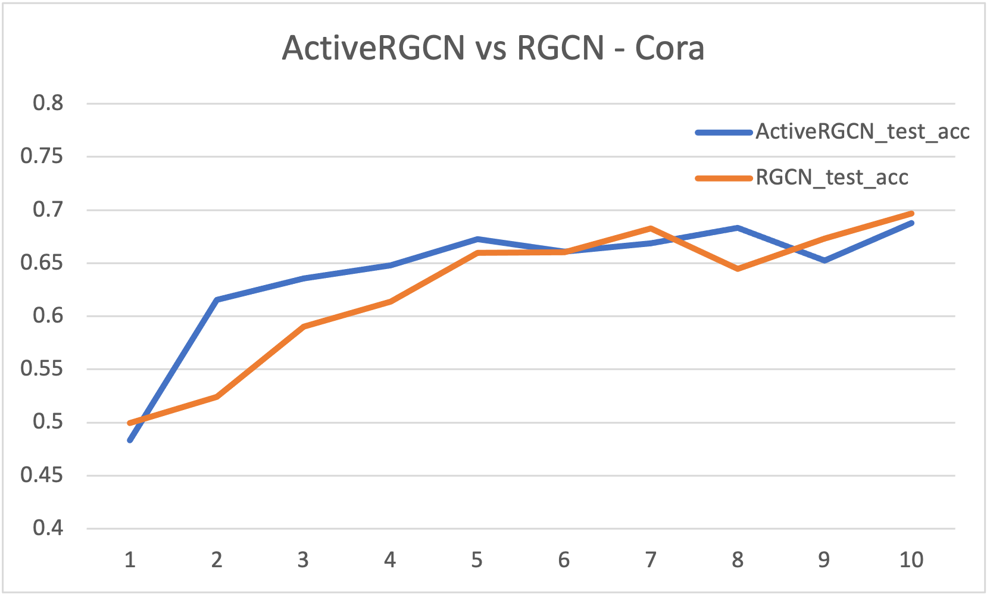
ActiveRGCN vs RGCN
test_acc
Tests on all three Dataset
Compare to RGCN, ActiveRGCN increase 5% accuracy for limited budget(less than 400 nodes), no significant difference in larger training set
num_iteration
Notes:
当budget number limited的时候，前面ActiveRGCN更好，重新做一下图

Slide 13
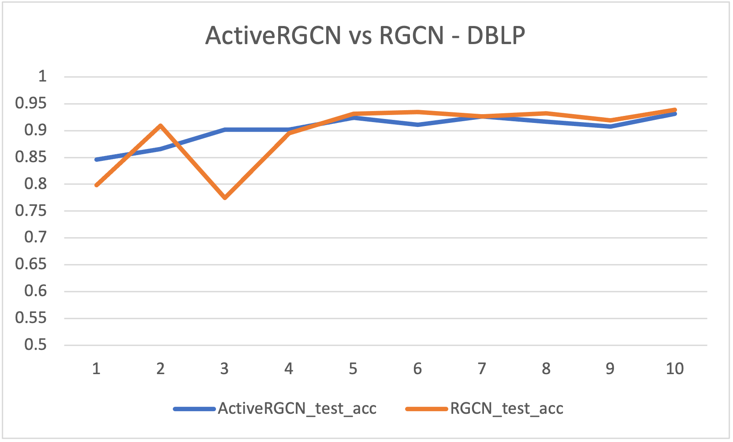
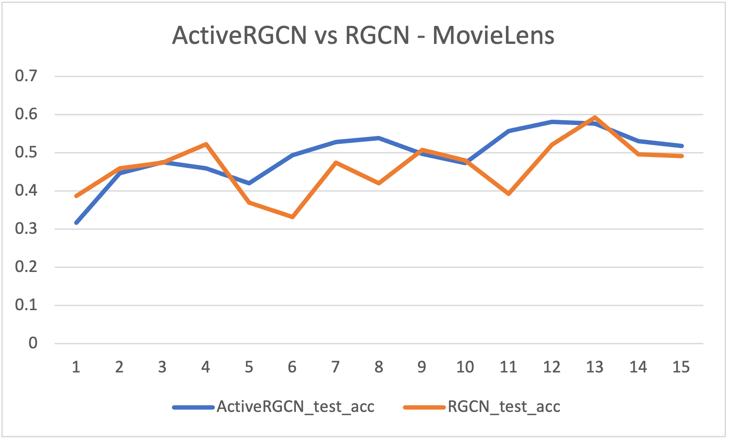
ActiveRGCN vs RGCN
test_acc
test_acc
num_iteration
num_iteration

Slide 14
Ablation Study 1: effectiveness of each reward
Active Learning Selection Strategy (Multi-armed Bendit mechanism):
Rewards[i] = NC_reward * NC_weight +
CIE_reward * CIE_weight +
CID_reward * CID_weight
Among three components, which one is most useful for the Selection Strategy?
We tested each component by removing the other two
Rewards_NC[i] = NC_reward * NC_weight
Rewards_CIE[i] = CIE_reward * CIE_weight
Rewards_CID[i] = CID_reward * CID_weight

Slide 15
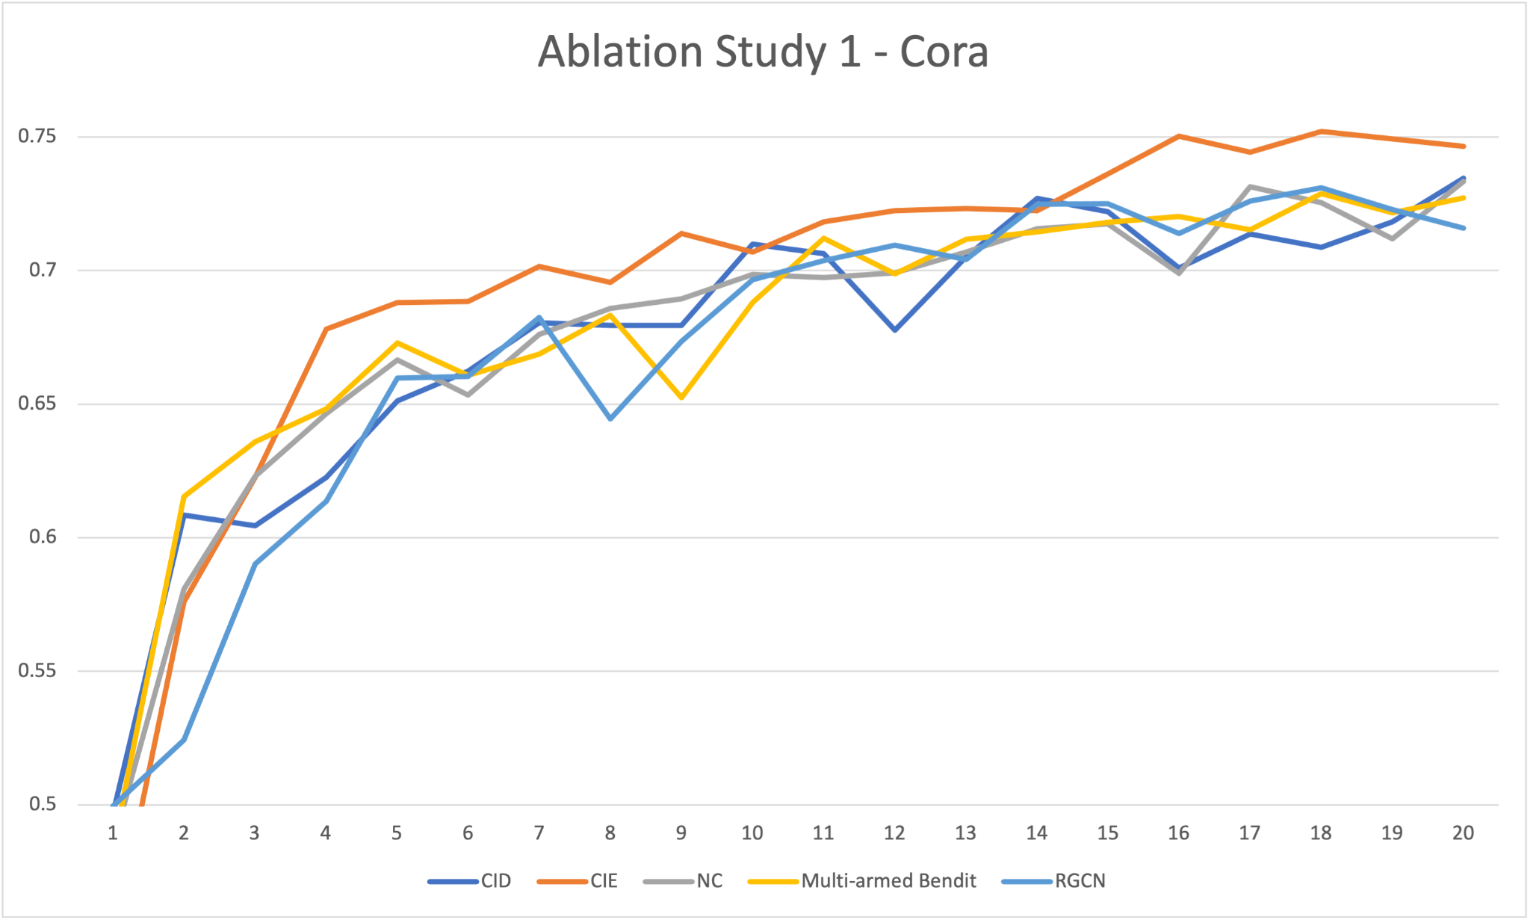
Ablation Study 1: effectiveness of each reward
Tests on Cora Dataset
All 4 tests used the same batch size and iteration number
CIE component curve (orange line) has the best accuracy result, even better than the Multi-armed Bendit curve (yellow line)
Compared to RGCN baseline, every reward is useful in finding valuable samples.

Slide 16
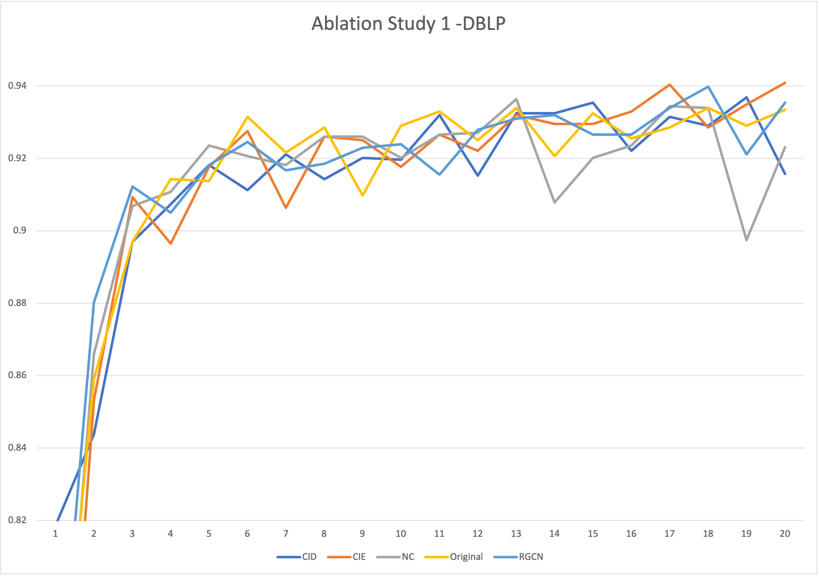
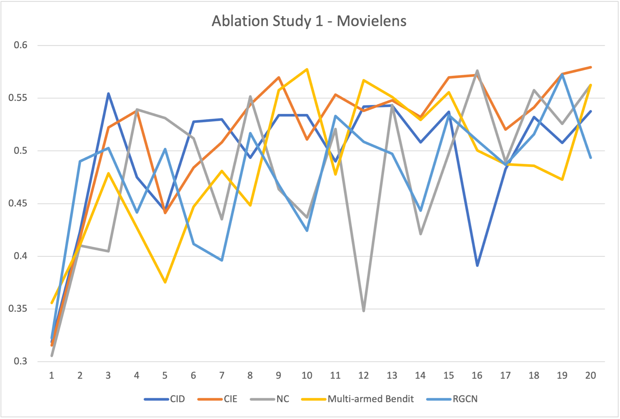
Ablation Study 1: effectiveness of each reward
Multi-armed Bendit
We did same experiments on DBLP and MovieLens Dataset
All rewards are useful in finding informative nodes
CIE curve (orange) has least variance, with relatively best accuracy result in three datasets
The Multi-armed Bendit setting curve did NOT achieve the best accuracy result in general

Slide 17
Ablation Study 1: effectiveness of each reward
Conclusion of the first ablation study:
CIE component contributes most to the Active Learning Reward System.
Each reward is a necessity in the Reward System
Multi-armed Bendit mechanism does NOT assign a good weight to each reward
This Leads to the second ablation study
We want to examine the validity of the Multi-armed Bendit mechanism.

Slide 18
Ablation Study 2: validity of multi-armed bandit
Multi-armed Bendit mechanism updates weight of each reward dynamically:
Rewards[i] = NC_reward * NC_weight +
CIE_reward * CIE_weight +
CID_reward * CID_weight
Is the weight update valid? Does it improve the performance of the Selection Strategy?
We tested its weight update by comparing it with the constant same-weight setting:
Rewards[i] = NC_reward * 0.33 +
CIE_reward * 0.33 +
CID_reward * 0.33

Slide 19
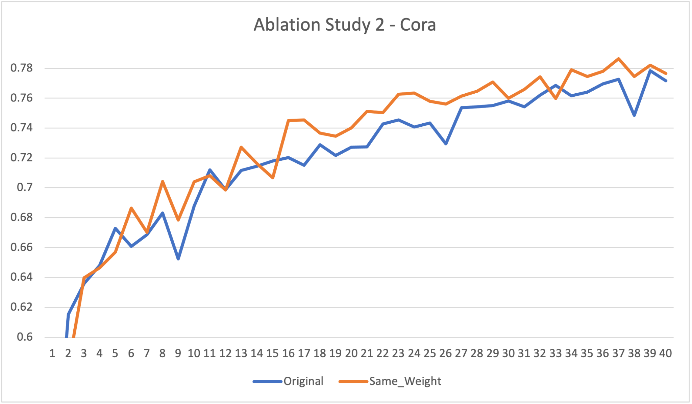
Ablation Study 2: validity of multi-armed bandit
Tests on Cora Dataset
Both two tests used the same batch size and iteration number
Simple Same-weight setting (orange line) has better accuracy result than the multi-armed bendit setting curve (blue line)
Multi-armed Bendit

Slide 20
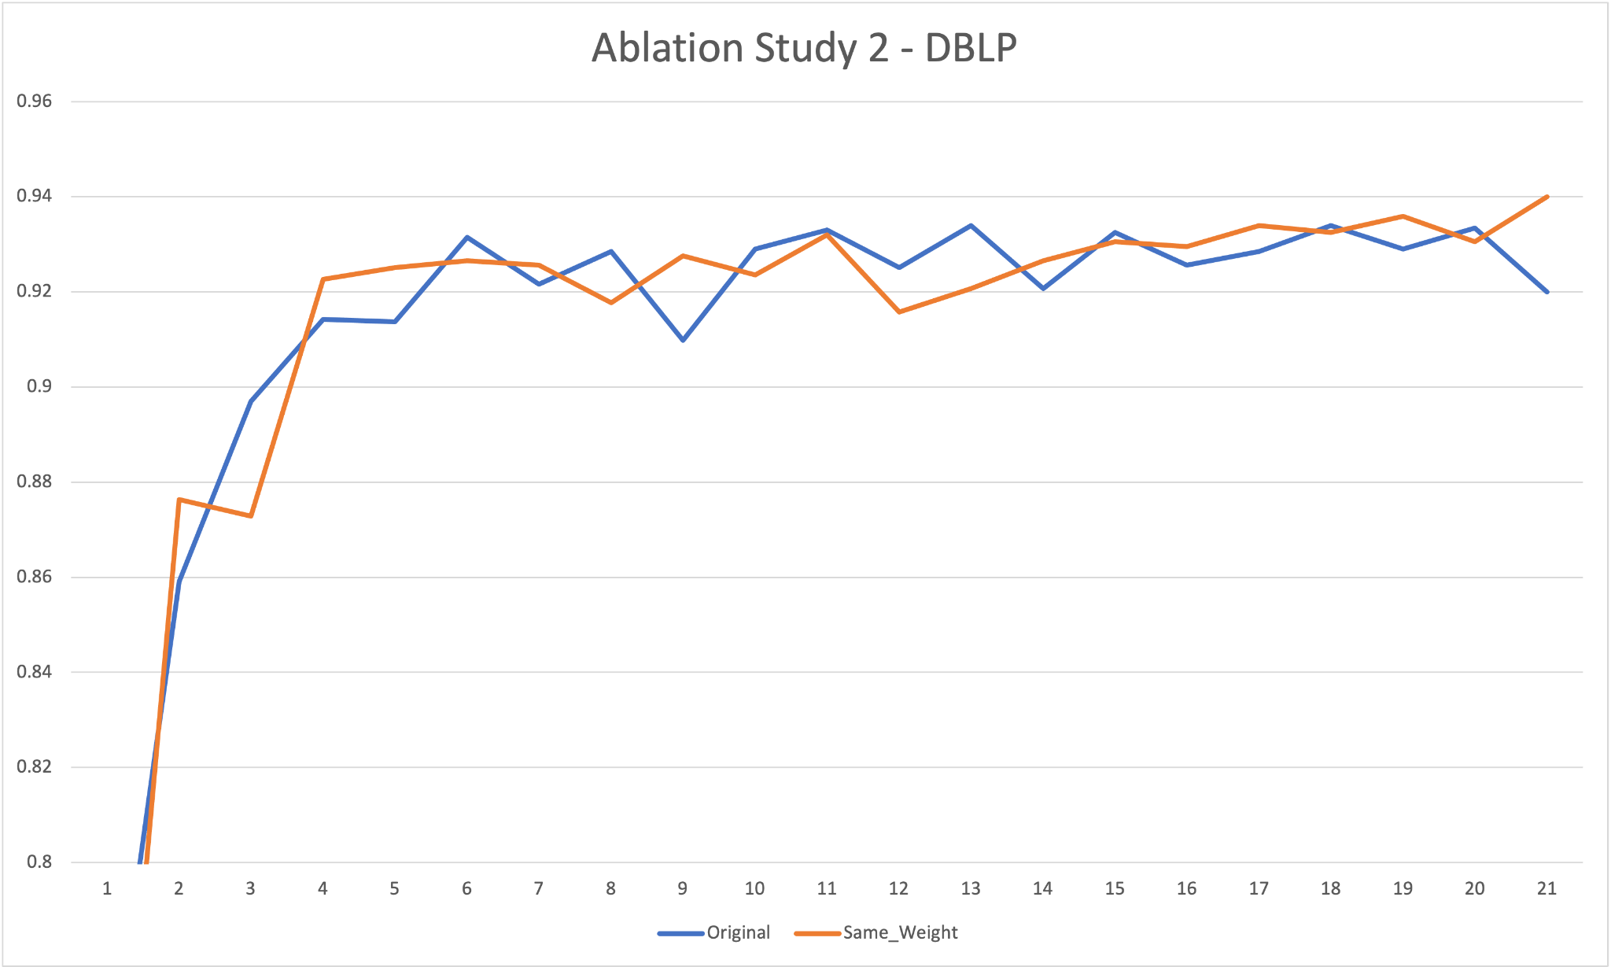
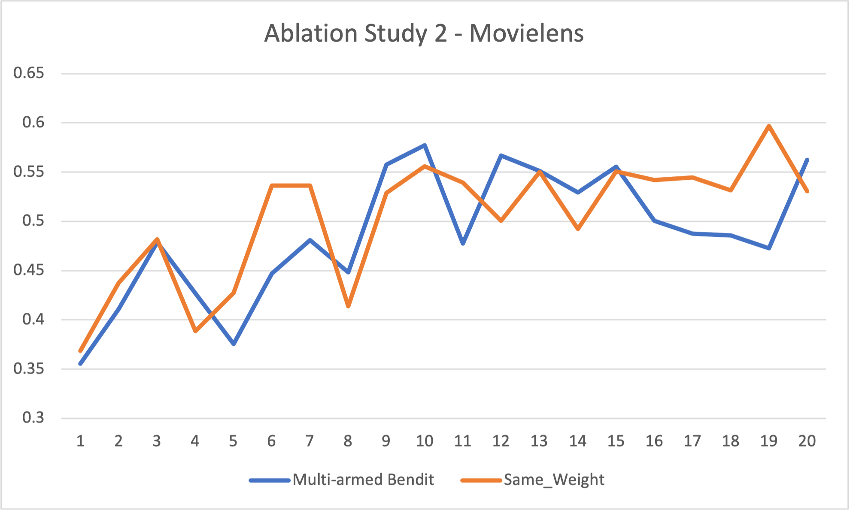
Ablation Study 2: validity of multi-armed bandit
Multi-armed Bendit
We did same experiments on DBLP and MovieLens Dataset
The same-weight setting curve has less variance, with relatively better accuracy result
The weight assignment logic in the Multi-armed Bendit mechanism needs to be improved

Slide 21
Conclusion of our Project
Active Select Algorithm is not model specific and can be applied to other GNNs
Compared to ActiveHNE, ActiveRGCN uses a simple GNN to achieve the same performance
Under a specific budget, ActiveRGCN has a better performance than the RGCN
Each reward is useful in finding informative samples
CIE component has the most contribution to the Active Select Reward system
The current Multi-armed Bendit mechanism needs to be improved in weight updates
Notes:
Not model specific, sample & modeL
Fiar experiment setting, don’t need complex GNNs, simple GNNs can also function well
Under a specific budget
Delete naive
Ablation study: clarify each score is useful, how to combine score properly; the current multi arm bendit mechanism is not good
Other setting can also function well, can explore in the future.
Multi-arm bendit instead of original

Slide 22
Future Work
Wrap up the current Active Learning Algorithm into an API
so that it can be easily applied to other GNNs, such as NARS and HAN
Improve the weight assignment logic in Multi-armed Bendit mechanism
Utilize the one-step Active Learning Algorithm in GraphPart paper
so that we can select all informative nodes at once
and speed up our Active Learning process

Slide 24
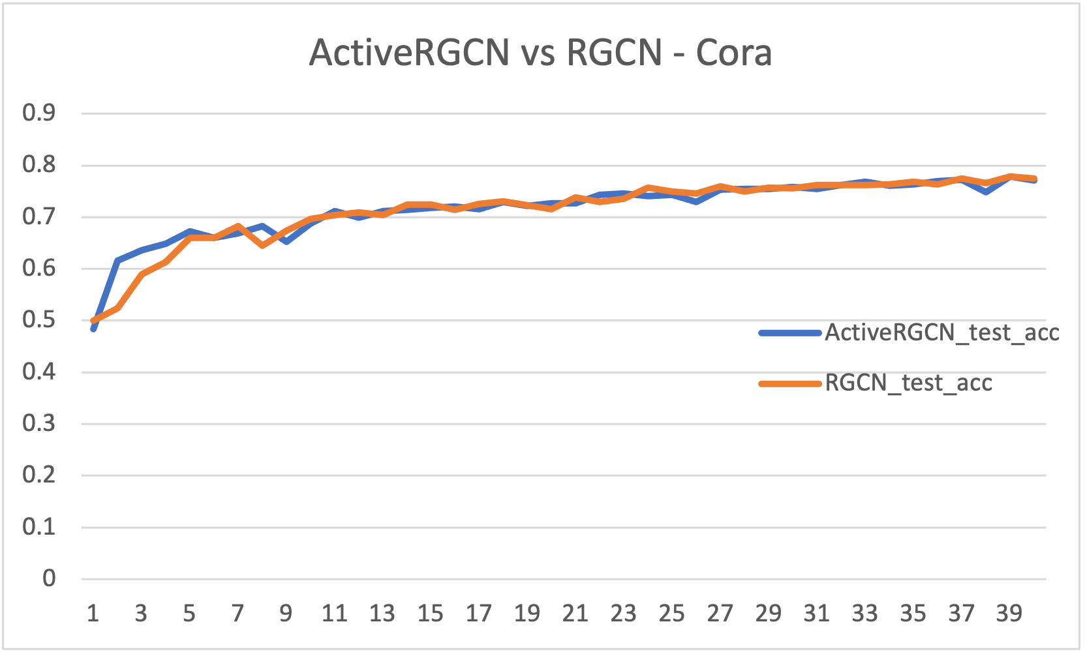
ActiveRGCN vs RGCN
test_acc
Tests on all three Dataset
Compare to RGCN, ActiveRGCN increase 5% accuracy for limited budget(less than 400 nodes), no significant difference in larger training set
With more budget, ActiveRGCN is more stable compared to RGCN
num_iteration
Notes:
当budget number limited的时候，前面ActiveRGCN更好，重新做一下图

Slide 25
ActiveHNE Problems: Hyperparameters
ActiveHNE uses Iteration = 40, Batch = 20, with 200 epochs in its study.
Labeled set too small comparing to Training set.
Training set size:
MovieLens: 918
DBLP: 1014
Cora: 3911
ActiveHNE uses 800 of them only.

Slide 26
Dataset & Setting
Dataset | Entities | Edges | Entity Type | Edge Type | class_num | Target Category | training set size
Cora | 56,670 | 244,088 | 3 | 3 | 10 | paper | 3911
DBLP | 37,791 | 170,803 | 4 | 3 | 4 | author | 1014
MovieLens | 28,491 | 138,352 | 4 | 4 | 3 | movie | 918
ActiveHNE setting: epoch 200, iteration 40, batch size 20 for all dataset, save the last epoch result
Our setting: epoch 50, iteration 40, batch size 80 for Cora, batch size 20 for DBLP and MovieLens, save the best model (lowest validation loss)

Slide 27
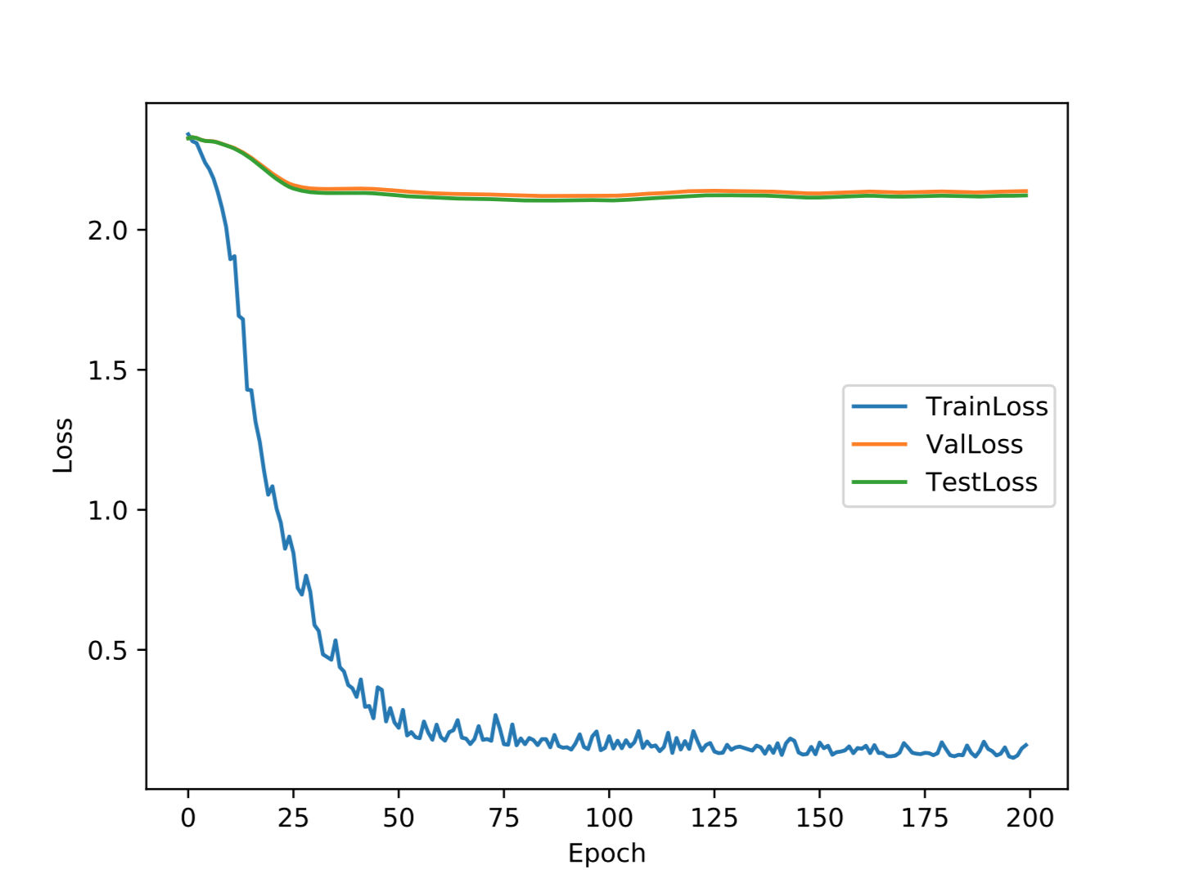
ActiveHNE Over-Fitting
MovieLens
Cora
ActiveHNE is overfitting with its original setting. We
Notes:
mention: not choose best model (可以hide)

Slide 28
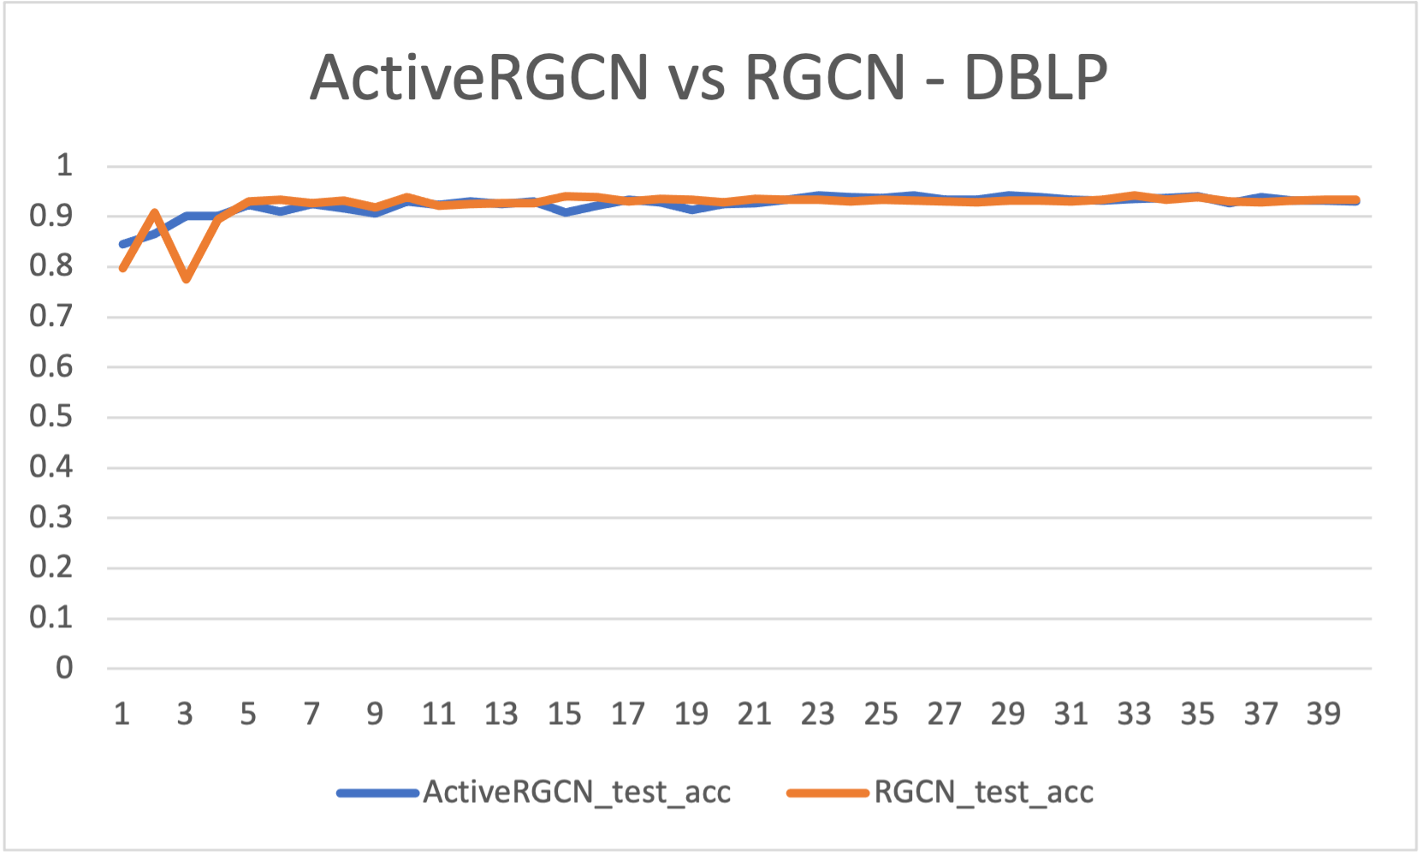
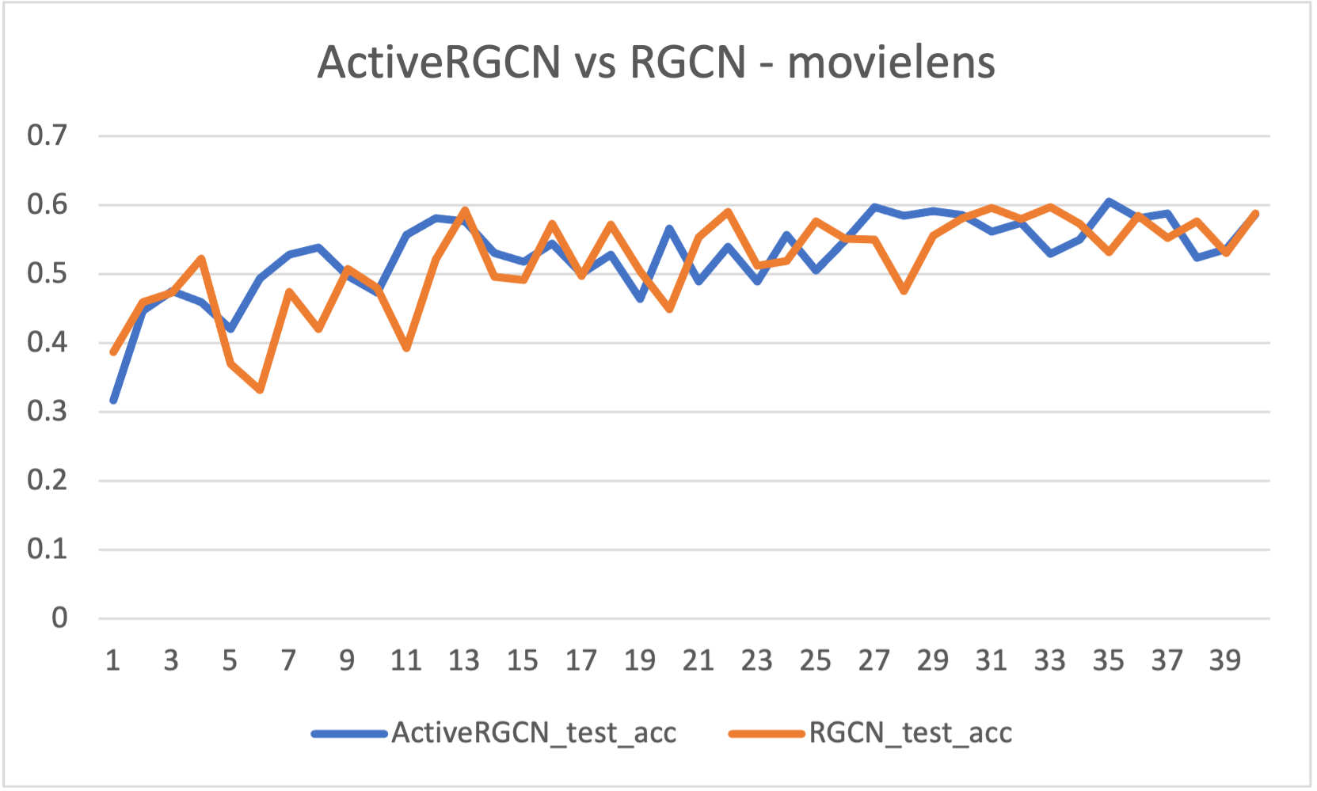
test_acc
test_acc
num_iteration
num_iteration

Slide 29
Representation Learning on HIN
Network embedding is a good way to capture the network structure and intrinsic information.
Improves the performance of downstream task: node classification, …
Typical solution: Unsupervised and semi-supervised
Semi-supervised methods:
Use supervised information (e.g. labels,) to improve performance compared with unsupervised methods.
Graph Neural Network:
Relational Graph Convolutional Network (RGCN)
Notes:
And network embeddings can also be applied to HIN and improve the performance of downstream tasks like node classifications. Compared with unsupervised network embedding methods, semi-supervised methods uses supervised information to improve performance, and in HIN, the Relational Graph Convolutional Network or RGCN is one representative.

Slide 30
Active Learning
One important problem of semi-supervised learning is the cost of gaining supervised information.
Active Learning (AL) proposed a solution to this problem:
Given a labelling budget, active learning framework selects some “informative” nodes for human experts to label.
RL-based method:
consider node selection as policy making, modeling it as a markov decision process.
Efficiency issue: query one sample at a time
Informative score-based method:
Use combinations of informative scores as selection criteria
Ignoring long-term performance
For homogeneous setting: GPA, AGE, etc..
Notes:
But one big problem of semi-supervised learning is the cost of gaining supervised information, and Active Learning can help. I think team 13 introduced Active learning in their great presentation, and for quick recap, active learning is to select some informative nodes for labeling with a given budget. Basically, there are Reinforcement Learning based methods like GPA which models the node selection as a markov decision process, and informative score-based method like AGE and Team 13 proposed, which calculate informative score as selection criteria.

